Slide 1

Talent Recognition & Retention Strategies

Slide 2
“Take away my factories, my plants; take away my railroads, my ships, my transportation; take away my money; strip me of all of these but leave me my people and in two or three years, I will have them all again.”
--Andrew Carnegie

Slide 3
Success is messy!
Organization leads to Success!
IT’S BOTH/AND!

Slide 4

Steps of Work Necessary for Success!
Ideas
Wonder
Invention
Activation
Discernment
Galvanizing
Implementation
Enablement
Tenacity

Slide 5
Value of Getting Organized
Individual Self Awareness
Better Communication and Efficiency
Better Teams and Team Members
Better Corporate Alignment

Slide 6
Talent Retention Planning Issues
From the Business Perspective
Need to retain and recruit talent without giving up equity
Flexibility to customize plans to suit business and personnel goals is key
Assess the impact to Balance Sheet and Income Statements
Regulatory and administrative issues must be addressed
From the Talent Perspective
Traditional Retirement plans (401k, 403b) limit ability to have tax-favored retirement planning…Supplemental retirement plans can help
Taxation of retirement and survivor benefits, including disability and Long-Term Care
Key person not having to pay out of pocket for valuable benefits

Slide 7

Finding the Right Balance is Key
Leverage
Tax Efficiency

Slide 8
Non-Qualified Benefit Plan Financing Vehicles Used

Slide 9
Retention Plan 1 - Executive Bonus Plan
“We’ve been paying attention to the great job you’ve been doing for the company and would like to introduce you to a special plan that would help you in the following areas”
Help you with your retirement savings
No additional cost or tax burden for you
Protect your family in the event you don’t make it all the way to retirement

Slide 10
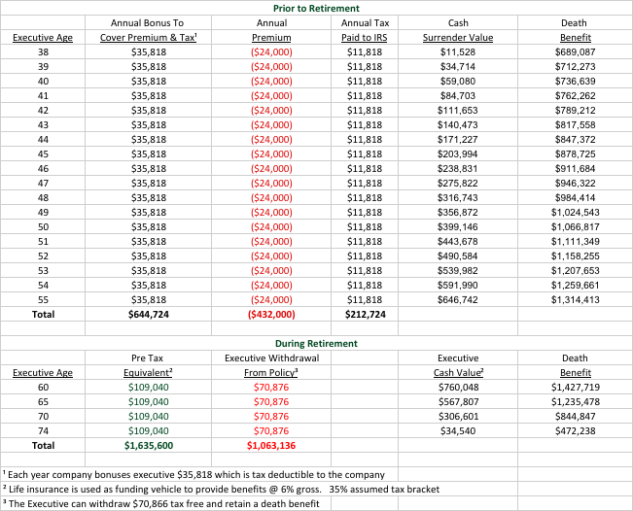
Executive Bonus Plan ~ Example

Slide 11
Retention Plan 2 – Supplemental Executive Retirement Plan
“We appreciate your hard work and dedication and would like for you to become a participant in our Special Benefit program”
By staying with the company, you will receive additional retirement income or other benefit
Protect your family in the event you don’t make it all the way to retirement
No cost to you as long as you stay in the plan

Slide 12
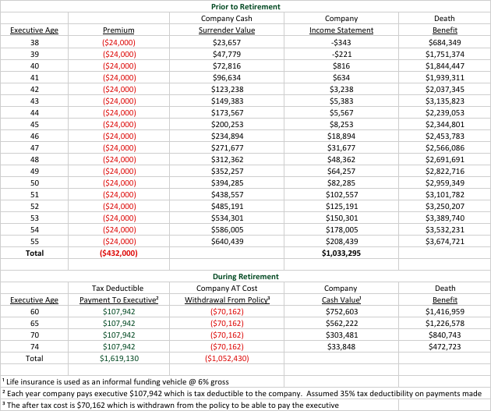
Supplemental Executive Retirement Plan ~ SERP Example

Slide 13
Strategic Use of Life Insurance – “Not Optimized”

Slide 14
Strategic Use of Life Insurance – “Optimized”
$10k tax free annual income improvement
21%

Slide 15

Case Study # 1
Ralph (62)
Ralph is known for his skills as an executive and being able to effect positive change as President. He has demonstrated his value to a large manufacturing corporation by moving it from verge of bankruptcy to profitability.
ACRU INSURANCE, LLC PROCESS
Complete Underwriting Advocate
Coordinate framework of SERP and get it approved by Business Owner and Legal Council
CLIENT IMPACT
Paying annual premium of $100,000 for 10 years will generate a pretax retirement benefit of $200,000 to Ralph for retirement.
The plan will also payout benefits to Ralph’s family if he dies or becomes disabled within the 10 years
“We want to show how much we appreciate him and we want him to remain in his position for the next several years.” — Business Owner

Slide 16

Case Study # 2
Jan
COO Jan is concerned about the underlying policy performance to support Executive Retirement plans for herself and two others. After six years, analysis shows the policies have not performed (-5.15%), and there is a $2,000,000 funding gap between what SERPs promise and what current policies will payout.
ACRU INSURANCE, LLC PROCESS
Collect “in-force” illustrations
Complete Underwriting Advocate
Freeze existing SERP and transfer policies
Create Executive Bonus plan with new policy purchase
CLIENT IMPACT
Each Executive will maintain their original retirement benefits.
The corporate $2,000,000 funding gap is closed by better performing policies and $320,000.
“I’m really glad that we decided to take the necessary steps to really understand this before it was too late”— Jan

Slide 17
Case Study # 3
Daniel
Daniel is a 47 year old Orthopedic Surgeon who earns $1.2m per year. He has $15k per month (15% of PTE) of “Group” LTD coverage through his employer. If he were to become disabled, this would be taxable income. By adding $15k per month of a Supplemental LTD policy that he pays for, his income protection now increases to 40% PTE
ACRU INSURANCE, LLC PROCESS
Complete Underwriting Advocate
Submit e-app for approval by Insurance Company
Check with others in the office to see about additional premium discounts
CLIENT IMPACT
Annual premium of $11,430 is < 1% of PTE
Significant improvement in income protection
Better risk transfer and leverage against potential future taxation of benefits
“When I looked into the details of the LTD plan through the company, I realized that my family and I were at risk. I wanted to be sure I had the income protection I needed just in case.”— Daniel

Slide 18
Thank You! Specialty areas where we can help… 1. Efficient Insurance Process 2. Repurposing Insurance 3. Talent Recognition and Retention

