Slide 1


Long Term Care Planning
Case Studies

Slide 2
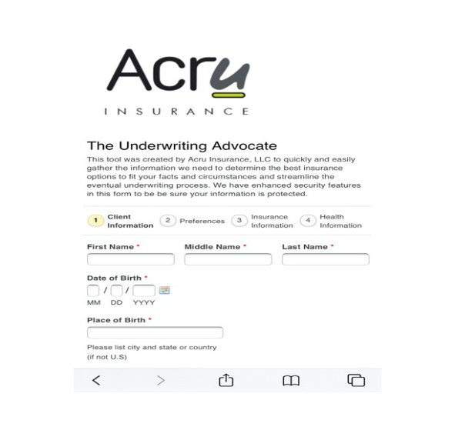
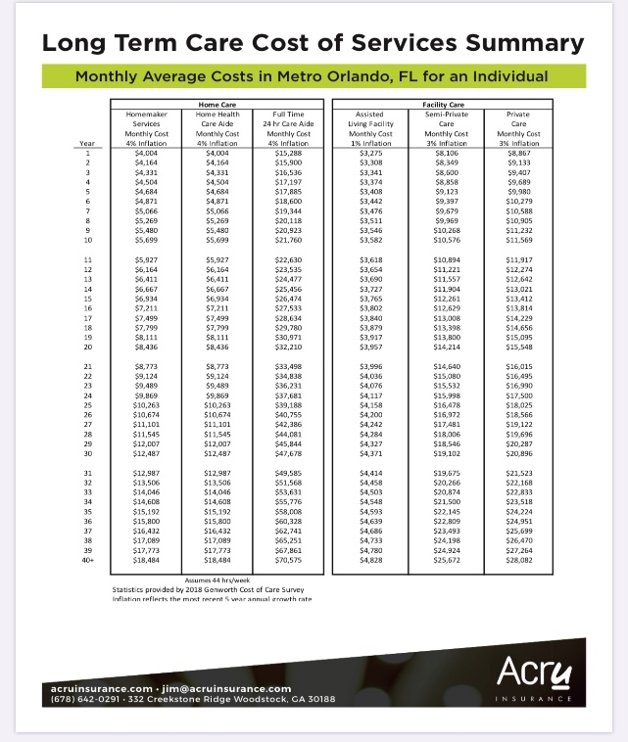
Tools
Underwriting Advocate
Cost of Care
Client Policy Summary

Slide 3
Insurance Approaches
Short & Stout v. Long & Lean
Value
Time
Maximize the greatest amount of monthly benefit for a shorter time vs extend a smaller monthly benefit over a long period of time

Slide 4

The Savvy Second Chancers – Pension Funded LTC
Ken (67) and Jane (64)
Ken will be retiring soon and has selected the lumpsum option for his $750k pension. They have planned well for retirement income needs but understand their plans are at risk. They are interested in revisiting their advisor’s longtime recommendation of LTC coverage to ensure their success.
INSURANCE PROCESS
Each completed the Underwriting Advocate
Both approved Preferred even after she was declined for Trad LTC
CLIENT IMPACT
Lifetime LTC protection for both outside of the IRA
$291k Life Insurance to heirs if there are no LTC claims
$36k IRA Income Annuity with 20% annual income bonus from the insurance company
“We looked at LTC insurance a few years ago but decided that it wasn’t a good purchase for us at the time. We now see that the potential risk of not having any coverage is too great…we hope to never use the LTC but it’s there if needed and if not, it goes to the kids. – Ken

Slide 5
The Savvy Second Chancers – Pension Funded LTC
Ken’s $750k
Pension Payout
Hybrid Survivorship Whole Life + LTC Rider
33 Months Acceleration of Benefits (AOB) - $8,724 per person
Continuation of Benefits (COB) – $8,724 for Life
Immediate Annuity with 20% annual income bonus pays premium for policy outside the IRA - $36k annually
All policy values are guaranteed for life
After
$36k annually
For 10 years
$291k Survivorship
Whole Life
$8,724 Monthly LTC Per Person
Unlimited
$300k

Slide 6

The Savvy Second Chancers – IRA Funded LTC
Wanda (70) and Charles (71)
Wanda and Charles are retired and have a large amount of their retirement assets in IRAs. Wanda had a poorly performing annuity inside of her IRA that the Advisor recommended cancelling. With Charles’s significant medical history, they recognized the need for LTC but were very concerned that he would not be eligible for any coverage.
INSURANCE PROCESS
Each completed the Underwriting Advocate
Preliminary inquiry resulted in a change to the recommendation
Phone interview only for the formal underwriting
CLIENT IMPACT
Lifetime LTC protection on both outside of the IRA
Increasing monthly LTC coverage, 3% inflation rider
Affordable premiums for Lifetime coverage
“We looked at LTC insurance a few years ago but decided that it wasn’t a good purchase for us at the time. We now see that the potential risk of not having any coverage is too great…thankful to have a second chance at getting covered. – Charles

Slide 7
The Savvy Second Chancers – IRA Funded LTC
Wanda’s IRA
Hybrid Annuity + LTC Rider
Charles is an “Eligible” person for LTC benefits
36 Months Acceleration of Benefits (AOB) - $3,483 per person
Lifetime Continuation of Benefits (COB) – 3% compound for Life
Annual premium paid outside the IRA - $2,965
Guaranteed for life
After
Unlimited
LTC
Benefits
$120k

Slide 8

The Hill Crestor
Frank (60)
Frank is an executive at a successful consulting firm and recent widow. He took time away from work to help his wife battle cancer and wanted to be sure his planning was in place to protect his kids and grandkids. He used a portion of death proceeds from the planning he and his wife had done several years ago to fund his ongoing plan.
INSURANCE PROCESS
Complete Underwriting Advocate
Determine the amount of protection desired
Complete underwriting for Hybrid policy
CLIENT IMPACT
$123,000 Single Premium; Mostly liquid
Life insurance benefit will be paid to a beneficiary if he never needs LTC services
Initial LTC monthly benefit of $7k with compound inflation of 3%
“I saw first-hand the benefit of having a plan and now I need to be thinking of how to protect my family if I need long-term care services.” – Frank
14

Slide 9
The Hill Crestor
After
Jerry’s Insurance Policy Summary
All policy values are guaranteed by Lincoln Life
15

Slide 10

Long-Term Care: Annuity Maximization
David (63) and Patricia (60)
David and Patricia have worked hard to accumulate assets. Through a policy review, it was pointed out that they did not have the LTC Insurance coverage that they thought they had. Adjustments to existing annuity and life insurance policies provided better protection for their family and now includes real LTC coverage.
INSURANCE PROCESS
Complete Underwriting Advocate
Review existing Annuity and Life policies
Recommend changes to existing policies to better suit current and future needs
CLIENT IMPACT
Increased total amount of coverage and added true LTC insurance
Created annuitized cash flow to spread out tax and fund Life+LTC Hybrid policies
Cut “out of pocket” premiums in half
“I’m really glad we had a review of our existing policies…otherwise we wouldn’t have known that we didn’t have the LTC protection we wanted” – David
3

Slide 11
Long-Term Care: Annuity Maximization
Life and Long Term Policy Benefits
David and Patricia
4

Slide 12
Long-Term Care: Annuity Maximization
Life and Long Term Policy Benefits
David and Patricia
5

Slide 13

Hybrid Annuity + LTC Policy
Richard (72) and Barbara (66)
Richard and Barbara have each owned variable annuities for many years and have built up significant taxable gains. They no longer want the market swings and are concerned about the potential impact of Long Term Care.
INSURANCE PROCESS
Complete Underwriting Advocate
Review existing annuity policy statements
Split the existing annuities into Hybrid and Indexed Annuities for each
CLIENT IMPACT
Protected approximately $500,000 each from potential LTC costs
Secured better options for growth without risk of loss of principal
“My concern is that the market will negatively impact the earnings we’ve attained. I’m also concerned that LTC issues will run down our assets”
– Richard
6

Slide 14
Hybrid Annuity + LTC Policy
Before
Richard and Barbara’s Annuity Summary
After
After
Richard and Barbara’s Annuity Summary
7

Slide 15
Personal Coverage
Greg (62) and Sherri (61)
Caring for Sherri’s mother-in-law has them concerned about their own long-term care needs.
INSURANCE PROCESS
Complete Underwriting Advocate
Collect ‘in-force’ illustration from existing carrier
Replace old policy with new policy
Purchase new long-term care insurance
CLIENT IMPACT
Saved $2,945 or 61% plus 20-year guaranteed extension over old policy.
Added $288,000 of LTC coverage with life insurance savings.
“I don’t want my kids to have to go through what I am with my mother-in-law.” – Greg
8

Slide 16
Personal Coverage
Before
Greg and Sherri Insurance Policy Summary
After
Greg and Sherri Insurance Policy Summary
9

Slide 17
Long-Term Care: Single Premium Hybrid Policy
Jerry (71)
Jerry has life insurance but does not have anything in place in the event an injury or illness requires long-term care. He wants to protect his family and be sure he is not a financial burden.
INSURANCE PROCESS
Complete Underwriting Advocate
Review existing life policy statements
Replace old life policies with new Hybrid policy
CLIENT IMPACT
Protected approximately $235,000 of his investment portfolio from LTC costs
Life insurance benefit will be paid to a beneficiary if he never needs LTC services
$74,606 liquidity is retained if ever needed
“I need to be thinking of how to protect my family if I need long-term care services.” – Jerry
14

Slide 18
Long-Term Care: Single Premium Hybrid Policy
Before
Jerry’s Insurance Policy Summary
Ownership | Policy Type | Insurance Company | Issue Date | Annual Premium | Net Cash Value | Guaranteed to | Total Benefits
Jerry | Whole Life | Union Central | 10-Oct-94 | $789 | $37,506 | 2044 | $126,874
Jerry | Whole Life | Prudential | 12-Nov-94 | $800 | $37,100 | 2048 | $157,653
Total Life Ins. |  |  |  | $4,589 | $74,606 |  | $284,527
Total for LTC |  |  |  | $0.00 |  |  | $0.00
After
Jerry’s Insurance Policy Summary
Ownership | Policy Type | Insurance Company | Issue Date | Annual Premium | Net Cash Value | Guaranteed to | Total Benefits
Jerry | Hybrid | Lincoln Life | 13-Dec-10 | $0 | $74,606 | Lifetime | $234,733
 |  |  |  |  |  |  | $2,794.44 Monthly LTC $99,388 Death Benefit
Total Life Ins. |  |  |  | $0 | $74,606 |  | $234,733
15

Slide 19

Long-Term Care: Business Owner
Jeff (52) and Terri (51)
Jeff and Terri started their business 9 years ago and have enjoyed profitability for several years. With no kids, their primary concern is making sure the other can continue to run the business if one of them has an extended injury or illness.
INSURANCE PROCESS
Complete Underwriting Advocate
Submit applications to LTC company for approval
Coordinate policy details with C.P.A. for deduction
CLIENT IMPACT
$2,800 annual tax deductions at current ages
LTC Coverage in place to protect most of the average cost associated with a potential claim
Corporation is paying for personal benefits with an allowable tax deduction
“I like the idea of being able to pay for a valuable benefit and receive a decent tax deduction for it.” – Jeff
16

Slide 20
Long-Term Care: Business Owner
Long Term Policy Benefits
Jeff and Terri
 |  |  | Jeff |  |  | Terri
 |  |  | Genworth |  |  | Genworth
 |  |  |  | Monthly | LTC Total Benefit |  | Monthly | LTC Total Benefit
Jeff | Terri |  | Total Annual¹ | Benefit | Reimbursement | Total Annual¹ | Benefit | Reimbursement
Age | Age | Year | Premium | 5% Compound | 4 year | Premium | 5% Compound | 4 year
52 | 51 | 1 | $1,563 | $5,000 | $240,000 | $1,757 | $5,000 | $240,000
53 | 52 | 2 | $1,563 | $5,250 | $252,000 | $1,757 | $5,250 | $252,000
54 | 53 | 3 | $1,563 | $5,513 | $264,600 | $1,757 | $5,513 | $264,600
55 | 54 | 4 | $1,563 | $5,788 | $277,830 | $1,757 | $5,788 | $277,830
56 | 55 | 5 | $1,563 | $6,078 | $291,722 | $1,757 | $6,078 | $291,722
57 | 56 | 6 | $1,563 | $6,381 | $306,308 | $1,757 | $6,381 | $306,308
58 | 57 | 7 | $1,563 | $6,700 | $321,623 | $1,757 | $6,700 | $321,623
59 | 58 | 8 | $1,563 | $7,036 | $337,704 | $1,757 | $7,036 | $337,704
60 | 59 | 9 | $1,563 | $7,387 | $354,589 | $1,757 | $7,387 | $354,589
61 | 60 | 10 | $1,563 | $7,757 | $372,319 | $1,757 | $7,757 | $372,319
Total |  |  | $15,635 |  |  | $17,575
62 | 61 | 11 | $1,563 | $8,144 | $390,935 | $1,757 | $8,144 | $390,935
63 | 62 | 12 | $1,563 | $8,552 | $410,481 | $1,757 | $8,552 | $410,481
64 | 63 | 13 | $1,563 | $8,979 | $431,006 | $1,757 | $8,979 | $431,006
65 | 64 | 14 | $1,563 | $9,428 | $452,556 | $1,757 | $9,428 | $452,556
66 | 65 | 15 | $1,563 | $9,900 | $475,184 | $1,757 | $9,900 | $475,184
67 | 66 | 16 | $1,563 | $10,395 | $498,943 | $1,757 | $10,395 | $498,943
68 | 67 | 17 | $1,563 | $10,914 | $523,890 | $1,757 | $10,914 | $523,890
69 | 68 | 18 | $1,563 | $11,460 | $550,084 | $1,757 | $11,460 | $550,084
70 | 69 | 19 | $1,563 | $12,033 | $577,589 | $1,757 | $12,033 | $577,589
71 | 70 | 20 | $1,563 | $12,635 | $606,468 | $1,757 | $12,635 | $606,468
Total |  |  | $31,269 |  |  | $35,150
72 | 71 | 21 | $1,563 | $13,266 | $636,791 | $1,757 | $13,266 | $636,791
73 | 72 | 22 | $1,563 | $13,930 | $668,631 | $1,757 | $13,930 | $668,631
74 | 73 | 23 | $1,563 | $14,626 | $702,063 | $1,757 | $14,626 | $702,063
75 | 74 | 24 | $1,563 | $15,358 | $737,166 | $1,757 | $15,358 | $737,166
76 | 75 | 25 | $1,563 | $16,125 | $774,024 | $1,757 | $16,125 | $774,024
77 | 76 | 26 | $1,563 | $16,932 | $812,725 | $1,757 | $16,932 | $812,725
78 | 77 | 27 | $1,563 | $17,778 | $853,361 | $1,757 | $17,778 | $853,361
79 | 78 | 28 | $1,563 | $18,667 | $896,030 | $1,757 | $18,667 | $896,030
80 | 79 | 29 | $1,563 | $19,601 | $940,831 | $1,757 | $19,601 | $940,831
81 | 80 | 30 | $1,563 | $20,581 | $987,873 | $1,757 | $20,581 | $987,873
Total |  |  | $46,904 |  |  | $52,725
82 | 81 | 31 | $1,563 | $21,610 | $1,037,266 | $1,757 | $21,610 | $1,037,266
After
17
Case Study

Slide 21
Long-Term Care: Annual Premium Hybrid Policy
David (60) and Debra (58)
David and Debra have worked hard to accumulate assets. They reviewed LTC Insurance several years ago but decided not to buy then. Now they want to make sure they have a basic amount to cover if something happens.
INSURANCE PROCESS
Complete Underwriting Advocate
Submit applications to LTC company for approval
Transfer cash value from Debra’s old policy
CLIENT IMPACT
LTC Benefits are paid in cash so that David and Debra are not restricted on who they pay for services
If no LTC Benefits are paid out, their family will receive the tax free death benefit
“We are just now at a point of having enough to retire…I want to be sure and cover a worst case scenario.” – David
18

Slide 22
Long-Term Care: Annual Premium Hybrid Policy
Life and Long Term Policy Benefits
David and Debra
 |  |  | David |  |  |  | Debra
 |  |  | Hybrid Life + Long Term Care |  |  |  | Hybrid Life + Long Term Care
 |  |  |  |  |  | Life + LTC Benefit |  |  | Life + LTC Benefit
David | Debra |  | Total Annual¹ | Monthly |  | Indemnity | Total Annual¹ | Monthly | Indemnity
Age | Age | Year | Premium | Benefit |  | 10% Residual | Premium | Benefit | 10% Residual
60 | 58 | 1 | $2,268 | $2,000 |  | $100,000 | $7,606 | $2,000 | $100,000
61 | 59 | 2 | $2,268 | $2,000 |  | $100,000 | $1,318 | $2,000 | $100,000
62 | 60 | 3 | $2,268 | $2,000 |  | $100,000 | $1,318 | $2,000 | $100,000
63 | 61 | 4 | $2,268 | $2,000 |  | $100,000 | $1,318 | $2,000 | $100,000
64 | 62 | 5 | $2,268 | $2,000 |  | $100,000 | $1,318 | $2,000 | $100,000
65 | 63 | 6 | $2,268 | $2,000 |  | $100,000 | $1,318 | $2,000 | $100,000
66 | 64 | 7 | $2,268 | $2,000 |  | $100,000 | $1,318 | $2,000 | $100,000
67 | 65 | 8 | $2,268 | $2,000 |  | $100,000 | $1,318 | $2,000 | $100,000
68 | 66 | 9 | $2,268 | $2,000 |  | $100,000 | $1,318 | $2,000 | $100,000
69 | 67 | 10 | $2,268 | $2,000 |  | $100,000 | $1,318 | $2,000 | $100,000
Total |  |  | $22,680 |  |  |  | $19,468
70 | 68 | 11 | $2,268 | $2,000 |  | $100,000 | $1,318 | $2,000 | $100,000
71 | 69 | 12 | $2,268 | $2,000 |  | $100,000 | $1,318 | $2,000 | $100,000
72 | 70 | 13 | $2,268 | $2,000 |  | $100,000 | $1,318 | $2,000 | $100,000
73 | 71 | 14 | $2,268 | $2,000 |  | $100,000 | $1,318 | $2,000 | $100,000
74 | 72 | 15 | $2,268 | $2,000 |  | $100,000 | $1,318 | $2,000 | $100,000
75 | 73 | 16 | $2,268 | $2,000 |  | $100,000 | $1,318 | $2,000 | $100,000
76 | 74 | 17 | $2,268 | $2,000 |  | $100,000 | $1,318 | $2,000 | $100,000
77 | 75 | 18 | $2,268 | $2,000 |  | $100,000 | $1,318 | $2,000 | $100,000
78 | 76 | 19 | $2,268 | $2,000 |  | $100,000 | $1,318 | $2,000 | $100,000
79 | 77 | 20 | $2,268 | $2,000 |  | $100,000 | $1,318 | $2,000 | $100,000
Total |  |  | $45,360 |  |  |  | $32,648
80 | 78 | 21 | $2,268 | $2,000 |  | $100,000 | $1,318 | $2,000 | $100,000
81 | 79 | 22 | $2,268 | $2,000 |  | $100,000 | $1,318 | $2,000 | $100,000
82 | 80 | 23 | $2,268 | $2,000 |  | $100,000 | $1,318 | $2,000 | $100,000
83 | 81 | 24 | $2,268 | $2,000 |  | $100,000 | $1,318 | $2,000 | $100,000
84 | 82 | 25 | $2,268 | $2,000 |  | $100,000 | $1,318 | $2,000 | $100,000
85 | 83 | 26 | $2,268 | $2,000 |  | $100,000 | $1,318 | $2,000 | $100,000
After
19
Case Study

Slide 23

Long-Term Care Annuity
Susan (61)
As a retired school teacher with no children and currently on Social Security disability income payments, Susan was concerned that she will need long-term care services in the future but is unable to qualify for Long-Term Care Insurance
INSURANCE PROCESS
$50,000 into NQ indexed annuity
She contributes $500 monthly to build up the value as much as possible
Add the Long Term Care Rider
CLIENT IMPACT
Guaranteed Principle, a Fixed-Income type return and a 5% bonus on all premiums being paid into the contract in the first four years with No Underwriting
If LTC is needed, she can enhance the payout by 10%
Annuitization options allow for her to never run out of money
“I need to find the best solution that protects my investment and allows me to pay for eventual need of long-term care” – Susan
24

Slide 24
Long-Term Care Annuity
Fixed Indexed Annuity with Long Term Care Enhancement
Susan, age 61
Insurance Company | Lincoln Life
Annuity Account Type | Non-Qualified
Product Name | Optipoint 8
Rate Band | >$100,000
Product Type | Fixed Index
Interest Crediting Method | S&P 500 2 Year Cao = 9% Fixed Rate = 3%
Guaranteed Interest | 1.00%
Premium Bonus | 5% on Premium in first 4 years
Surrender Charges
Year 1 | 9.00%
Year 2 | 9.00%
Year 3 | 9.00%
Year 4 | 8.00%
Year 5 | 7.00%
Year 6 | 6.00%
Year 7 | 5.00%
Year 8 | 4.00%
Year 9 | 0.00%
Year 10 | 0.00%
Income Withdrawal Benefit | N/A
Death Benefit | 10% Income Enhancement upon entering a Qualified LTC Facility
Death Benefit | < Account or Guarantee Value
Nursing Home Waiver | Yes
Withdrawal Provision | 10% after year 1
Premium | Flexible Premium
After
25

Slide 25
Existing Long-Term Care Policy Recommendation
Gerald (77) and Cynthia (73)
Gerald and Cynthia are long-time LTC policy holders that have just received notice that their premium will increase 80%. They are presented with alternatives and need guidance on which option to choose.
INSURANCE PROCESS
Review insurance company options provided
Benchmark current costs of LTC services in the market against policy features & benefits
Provide written recommendation
CLIENT IMPACT
Better alignment of their insurance policy into their total financial plan
Confirmation that their policy is relevant to cover their desired risk exposure
Peace of mind
“What should I do about this increase? What if they come back next year and ask for another increase?” – Gerald
26

Slide 26
Existing Long-Term Care Policy Recommendation
The Long Term Care Report
Gerald (77) and Cynthia (73)
27

Slide 27

Income Annuity
Ilene (62)
Ilene isn’t quite sure why she has three annuities and is not sure about how they are performing.
INSURANCE PROCESS
Conference call with each insurance company to verify fees of VA contracts
Coordinate with Associate and client to determine needed income
Cancel / Reposition + BOR
CLIENT IMPACT
Setup guaranteed 10-year income stream with smallest amount necessary.
Pooled $265,368 of other funds at significantly lower fees.
“I’d like to increase my income but don’t know if I can. I can’t figure out how these products are supposed to work.” – Ilene
28

Slide 28
Existing Annuity Policy Recommendation
Annuity Policy Summary
Ilene, Age 64
 | Protective | John Hancock | Lincoln Life | LPL IRA
Product Type | Variable Annuity | Variable Annuity | Variable Annuity | Franklin Income Fund
Issue Date | 6-Dec-09 | 8-Dec-07 | 26-Feb-10
Market Value (As of Statements) | $122,814.14 | $116,270.58 | $105,966.95 | $102,784.40
Current Distributions | $0.00 | $551.25 Monthly | $508.18 Monthly
Total Fees | 2.85% | 3.25% | 3.55%
Single Premium Immediate Annuity – 10-year Certain
Age | Year | Deposit | Monthly Income | Annualized Income | No Inflation Income | Aggregate Payout
64 | 1 | $104,189 | $1,143.29 | $13,719.48 | $13,719.48 | $13,719.48
65 | 2 |  |  |  | $13,719.48 | $27,438.96
66 | 3 |  |  |  | $13,719.48 | $41,158.44
67 | 4 |  |  |  | $13,719.48 | $54,877.92
68 | 5 |  |  |  | $13,719.48 | $68,597.40
69 | 6 |  |  |  | $13,719.48 | $82,316.88
70 | 7 |  |  |  | $13,719.48 | $96,036.36
71 | 8 |  |  |  | $13,719.48 | $109,755.84
29

