Slide 1


Individual and Small Business
Case Studies

Slide 2
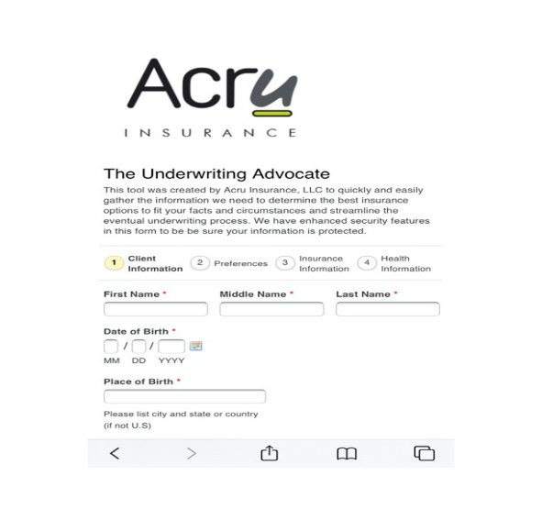
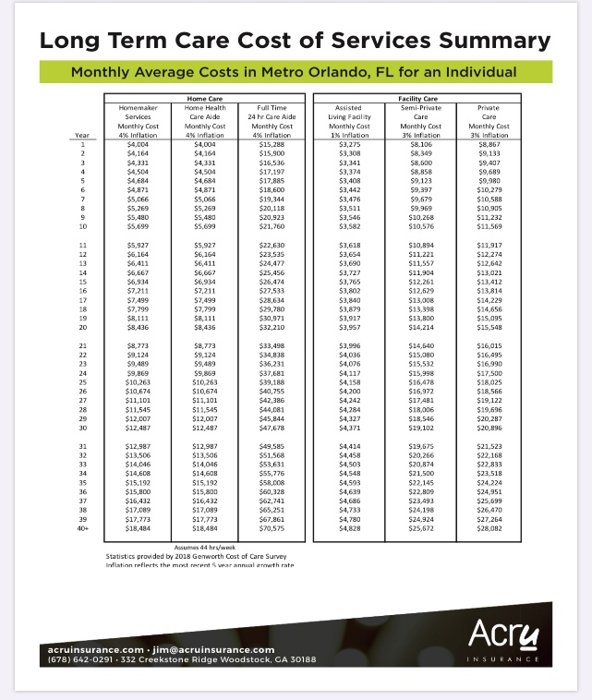
Tools
Underwriting Advocate
Cost of Care
Client Policy Summary

Slide 3

Personal Coverage
Dan (54)
Dan is transitioning out of a corporation into consulting and wants to make sure his family is protected. His life insurance will reduce dramatically after leaving his corporate job. He needs to find the best way to protect his family during this transition.
INSURANCE PROCESS
Complete Underwriting Advocate
Collect ‘in-force’ illustration from existing carrier
Tailor his life insurance plan with his other planning to determine the appropriate amount, type, and term.
CLIENT IMPACT
Optimize use of existing policies with new polices to create a “tiered” approach to future life insurance needs.
Add new 20 and 30 year term for total of $1.5M of new coverage to replace corp. coverage.
“I need to replace the life insurance coverage I am giving up when I leave the corporate life.” – Dan
10

Slide 4
Personal Coverage
Tiered Policy Structure
Dan, age 54
 |  |  | $1,500,000 |  |  | $1,000,000 |  |  | $500,000 |  |  | Tiered Policies
 |  |  | Original 20 Year Term |  |  | 20 Year Term |  |  | 30 Year Term
 |  |  | Northwestern Mutual Life |  |  | Principal Life |  |  | Principal Life
 |  |  | Projected¹ | Death |  | Life² | Death |  | Life² | Death |  | Life | Death
Age | Year |  | Premium | Benefit |  | Premium | Benefit |  | Premium | Benefit |  | Premium | Benefit
54 | 1 |  | $2,453 | $1,500,000 |  | $3,126.60 | $1,000,000 |  | $3,539.65 | $500,000 |  | $9,119.25 | $3,000,000
55 | 2 |  | $2,438 | $1,500,000 |  | $3,126.60 | $1,000,000 |  | $3,539.65 | $500,000 |  | $9,104.25 | $3,000,000
56 | 3 |  | $2,408 | $1,500,000 |  | $3,126.60 | $1,000,000 |  | $3,539.65 | $500,000 |  | $9,074.25 | $3,000,000
57 | 4 |  | $2,393 | $1,500,000 |  | $3,126.60 | $1,000,000 |  | $3,539.65 | $500,000 |  | $9,059.25 | $3,000,000
58 | 5 |  | $2,378 | $1,500,000 |  | $3,126.60 | $1,000,000 |  | $3,539.65 | $500,000 |  | $9,044.25 | $3,000,000
59 | 6 |  | $2,333 | $1,500,000 |  | $3,126.60 | $1,000,000 |  | $3,539.65 | $500,000 |  | $8,999.25 | $3,000,000
60 | 7 |  | $2,318 | $1,500,000 |  | $3,126.60 | $1,000,000 |  | $3,539.65 | $500,000 |  | $8,984.25 | $3,000,000
61 | 8 |  | $2,273 | $1,500,000 |  | $3,126.60 | $1,000,000 |  | $3,539.65 | $500,000 |  | $8,939.25 | $3,000,000
62 | 9 |  |  |  |  | $3,126.60 | $1,000,000 |  | $3,539.65 | $500,000 |  | $6,666.25 | $1,500,000
63 | 10 |  |  |  |  | $3,126.60 | $1,000,000 |  | $3,539.65 | $500,000 |  | $6,666.25 | $1,500,000
Total |  |  | $18,994.00 |  |  | $31,266 |  |  | $35,397 |  |  | $85,657
64 | 11 |  |  |  |  | $3,126.60 | $1,000,000 |  | $3,539.65 | $500,000 |  | $6,666.25 | $1,500,000
65 | 12 |  |  |  |  | $3,126.60 | $1,000,000 |  | $3,539.65 | $500,000 |  | $6,666.25 | $1,500,000
66 | 13 |  |  |  |  | $3,126.60 | $1,000,000 |  | $3,539.65 | $500,000 |  | $6,666.25 | $1,500,000
67 | 14 |  |  |  |  | $3,126.60 | $1,000,000 |  | $3,539.65 | $500,000 |  | $6,666.25 | $1,500,000
68 | 15 |  |  |  |  | $3,126.60 | $1,000,000 |  | $3,539.65 | $500,000 |  | $6,666.25 | $1,500,000
69 | 16 |  |  |  |  | $3,126.60 | $1,000,000 |  | $3,539.65 | $500,000 |  | $6,666.25 | $1,500,000
70 | 17 |  |  |  |  | $3,126.60 | $1,000,000 |  | $3,539.65 | $500,000 |  | $6,666.25 | $1,500,000
71 | 18 |  |  |  |  | $3,126.60 | $1,000,000 |  | $3,539.65 | $500,000 |  | $6,666.25 | $1,500,000
72 | 19 |  |  |  |  | $3,126.60 | $1,000,000 |  | $3,539.65 | $500,000 |  | $6,666.25 | $1,500,000
73 | 20 |  |  |  |  | $3,126.60 | $1,000,000 |  | $3,539.65 | $500,000 |  | $6,666.25 | $1,500,000
Total |  |  |  |  |  | $62,532 |  |  | $70,793 |  |  | $152,319
74 | 21 |  |  |  |  |  |  |  | $3,539.65 | $500,000 |  | $3,539.65 | $500,000
75 | 22 |  |  |  |  |  |  |  | $3,539.65 | $500,000 |  | $3,539.65 | $500,000
76 | 23 |  |  |  |  |  |  |  | $3,539.65 | $500,000 |  | $3,539.65 | $500,000
77 | 24 |  |  |  |  |  |  |  | $3,539.65 | $500,000 |  | $3,539.65 | $500,000
78 | 25 |  |  |  |  |  |  |  | $3,539.65 | $500,000 |  | $3,539.65 | $500,000
79 | 26 |  |  |  |  |  |  |  | $3,539.65 | $500,000 |  | $3,539.65 | $500,000
80 | 27 |  |  |  |  |  |  |  | $3,539.65 | $500,000 |  | $3,539.65 | $500,000
81 | 28 |  |  |  |  |  |  |  | $3,539.65 | $500,000 |  | $3,539.65 | $500,000
82 | 29 |  |  |  |  |  |  |  | $3,539.65 | $500,000 |  | $3,539.65 | $500,000
83 | 30 |  |  |  |  |  |  |  | $3,539.65 | $500,000 |  | $3,539.65 | $500,000
Total |  |  |  |  |  |  |  |  | $106,190 |  |  | $187,716
 | SA |  |  |  |  | $1,602.38 |  |  | $1,814.07 |  |  | $3,416.45
 | Q |  |  |  |  | $820.73 |  |  | $929.16 |  |  | $1,749.89
 | M |  |  |  |  | $273.58 |  |  | $309.72 |  |  | $583.30
11
Case Study

Slide 5

Business Owner Coverage
Bill and Jill
Bill’s wife Jill has a health scare, which forces him to think about “getting things in order.” As a successful small-business owner, Bill’s disability insurance does not protect his current income level, and he personally owns his term life policy. Jill also runs a small business, but would like to stop working.
INSURANCE PROCESS
Complete Underwriting Advocate
Establish Irrevocable Life Insurance Trust (ILIT) and purchase new policy
Transfer existing policy to ILIT
Add Disability Insurance
CLIENT IMPACT
Recommending a trust creates flexibility for his estate. New $1M term policy 20-year coverage
Jill begins to seek out ways to exit her business
Disability coverage protects lifestyle
“I want to be sure my wife and family are protected if I become disabled.” – Bill
5

Slide 6
Business Owner Coverage
Before
Insurance Policy Summary
Ownership | Policy Number | Policy Type | Insurance Company | Issue Date | Annual Premium | Guaranteed to | Total Benefits
Bill |  | Term | USAA | 10-Oct-04 | $620 | 2024 | $500,000
Bill |  | Term | Genworth | 26-Jan-07 | $1,234 | 2027 | $500,000
Total Life Ins. |  |  |  |  | $1,854 |  | $1,000,000
Bill |  | Disability | Guardian | 1-Sep-08 | $5,516 |  | $8,350 / Monthly
Total Disability Ins. |  |  |  |  | $5,516
After
Insurance Policy Summary
Ownership | Policy Number | Policy Type | Insurance Company | Issue Date | Annual Premium | Guaranteed to | Total Benefits
Family Trust |  | Term | USAA | 10-Oct-04 | $620 | 2024 | $500,000
Family Trust |  | Term | Lincoln Life | 15-Jun-12 | $1,1780 | 2032 | $1,000,000
Total Life Ins. |  |  |  |  | $2,400 |  | $1,500,000
Bill |  | Disability | Guardian | 1-Sep-08 | $5,516 |  | $8,350 / Monthly
Bill |  | Disability | Guardian | 15-Jun-12 | $4,730 |  | $7,310 / Monthly
Total Disability Ins. |  |  |  |  | $10,246 |  | $15,660 / Monthly
6

Slide 7

Business Insurance Coverage
Seth, Ed and Kyle
They are equal partners in a rapidly growing business that would like a loan to fund their growth plans. As they were sharing their business plan, the banker asked if they had a Buy/Sell Agreement.
INSURANCE PROCESS
Complete Underwriting Advocate for each Executive
Apply for $2,000,000 of company-owned term
Part Buy/Sell, Part Key-Man
Place new policies in-force
CLIENT IMPACT
Two of three came back from UW as quoted or better.
Shopped eight other companies to try to improve offer.
Seek to improve existing personal policies on two of three.
“We want to make changes to our existing Buy/Sell Agreement and put life insurance in place to fund it.” – Seth
30

Slide 8
Business Insurance Coverage
Insurance Proposal Summary
Based on answers provided in Underwriting Advocate
Life Insurance Coverage - $1,000,000 for Buy/Sell Agreement
Principal 10-Year Term |  |  |  |  |  | Lincoln Life 10-Year Term |  |  |  |  | John Hancock 10-Year Term
Year | Executive 1 | Executive 2 | Executive 3 | Total |  | Executive 1 | Executive 2 | Executive 3 | Total |  | Executive 1 | Executive 2 | Executive 3 | Total
1 | $464.30 | $1,115.00 | $504.10 | $2,083.40 |  | $600.00 | $1,100.00 | $630.00 | $2,340.00 |  | $560.00 | $1,300.00 | $600.00 | $2,460.00
2 | $464.30 | $1,115.00 | $504.10 | $2,083.40 |  | $600.00 | $1,100.00 | $630.00 | $2,340.00 |  | $560.00 | $1,300.00 | $600.00 | $2,460.00
3 | $464.30 | $1,115.00 | $504.10 | $2,083.40 |  | $600.00 | $1,100.00 | $630.00 | $2,340.00 |  | $560.00 | $1,300.00 | $600.00 | $2,460.00
4 | $464.30 | $1,115.00 | $504.10 | $2,083.40 |  | $600.00 | $1,100.00 | $630.00 | $2,340.00 |  | $560.00 | $1,300.00 | $600.00 | $2,460.00
5 | $464.30 | $1,115.00 | $504.10 | $2,083.40 |  | $600.00 | $1,100.00 | $630.00 | $2,340.00 |  | $560.00 | $1,300.00 | $600.00 | $2,460.00
6 | $464.30 | $1,115.00 | $504.10 | $2,083.40 |  | $600.00 | $1,100.00 | $630.00 | $2,340.00 |  | $560.00 | $1,300.00 | $600.00 | $2,460.00
7 | $464.30 | $1,115.00 | $504.10 | $2,083.40 |  | $600.00 | $1,100.00 | $630.00 | $2,340.00 |  | $560.00 | $1,300.00 | $600.00 | $2,460.00
8 | $464.30 | $1,115.00 | $504.10 | $2,083.40 |  | $600.00 | $1,100.00 | $630.00 | $2,340.00 |  | $560.00 | $1,300.00 | $600.00 | $2,460.00
9 | $464.30 | $1,115.00 | $504.10 | $2,083.40 |  | $600.00 | $1,100.00 | $630.00 | $2,340.00 |  | $560.00 | $1,300.00 | $600.00 | $2,460.00
10 | $464.30 | $1,115.00 | $504.10 | $2,083.40 |  | $600.00 | $1,100.00 | $630.00 | $2,340.00 |  | $560.00 | $1,300.00 | $600.00 | $2,460.00
SA | $237.96 | $571.44 | 258.35 | $1,067.75 |  | $309.00 | $571.65 | $324.45 | $1,205.10 |  | $286.90 | $668.00 | $307.50 | $1,262.40
Q | $121.88 | $292.69 | $132.33 | $546.90 |  | $157.20 | $209.82 | $324.45 | $613.08 |  | $148.90 | $345.00 | $159.50 | $653.40
M | $40.62 | $97.56 | $44.11 | $182.29 |  | $53.40 | $98.79 | $56.07 | $208.26 |  | $52.25 | $117.00 | $55.75 | $225.00
After
Approved Insurance Summary for XYZ Corp
Principal 10-Year Term
Year | Executive 1 | Executive 2 | Executive 3 | Total
1 | $464.30 | $4,775.00 | $504.10 | $5,743.40
2 | $464.30 | $4,775.00 | $504.10 | $5,743.40
3 | $464.30 | $4,775.00 | $504.10 | $5,743.40
4 | $464.30 | $4,775.00 | $504.10 | $5,743.40
5 | $464.30 | $4,775.00 | $504.10 | $5,743.40
6 | $464.30 | $4,775.00 | $504.10 | $5,743.40
7 | $464.30 | $4,775.00 | $504.10 | $5,743.40
8 | $464.30 | $4,775.00 | $504.10 | $5,743.40
9 | $464.30 | $4,775.00 | $504.10 | $5,743.40
10 | $464.30 | $1,115.00 | $504.10 | $2083.40
SA | $237.96 | $2,436.94 | $258.35 | $2,933.25
Q | $121.88 | $1,248.19 | $132.33 | $1,502.40
M | $40.62 | $416.06 | $44.11 | $500.79
31

Slide 9

Personal Coverage
Charlie (44)
Charlie purchased life insurance 15 years ago. He pays a $4,076 annual premium for $728,498 in death benefit. He currently has $59,823 in available cash.
INSURANCE PROCESS
Complete Underwriting Advocate
Collect ‘in-force’ illustration from existing carrier
Transfer old policy values into new policy
CLIENT IMPACT
Saved $2,924 or 71% in ongoing premium and maintained a guaranteed policy for life.
He is now using the savings to invest in his retirement plans.
“I’ve changed my mindset regarding life insurance. What I am most interested in now is lower premium.” – Charlie
32

Slide 10
Personal Coverage
Before
Charlie Insurance Policy Summary
Charlie Insurance Policy Summary
After
33

