Slide 1

Executive Benefit Strategies

Slide 2
The Non-Qualified Planning Issues
For the Business
Need to recruit and retain executive talent without giving up equity
Need flexibility to customize plans to suit business goals
NQ plan’s impact to Balance Sheet and Income Statements
Desire for minimal ongoing administration
For the Key Person ~ Highly Compensated
Qualified plans limit Key Person’s ability to have tax-favored retirement planning. Supplemental retirement plans can help
Taxation of retirement and survivor benefits, including disability and Long Term Care
NQ plans can be instrumental to the future success of the business and tremendous value for Key Person not having to pay out of pocket

Slide 3
Types of Non-Qualified Plans
Executive Bonus Plan
Business customizes additional compensation to fit strategic objectives
Supplemental Executive Retirement Plan ~ SERP
Business creates non-qualified plan to provide additional benefits
Deferred Compensation Plan
Each Key Person annually defers their own compensation
Split Benefit Plan
Owners customize individual retirement benefits and corporate succession

Slide 4
Executive Bonus Plan
Summary
    The Business rewards a Key Person by executing a simple plan to pay the annual premium for a strategically designed life insurance policy.
    The Business can deduct the amount paid into the policy as a business expense under IRC Sec. 162.
    The Key Person recognizes premium amount as compensation, pays current year income tax and will own the policy. The Key Person will name their own beneficiaries and build cash value for eventual tax-free distributions as supplemental retirement income.
    The Executive Bonus plan is simple to administer, requires no IRS approval and the Business can select which employees are eligible and discriminate in the amount of premium paid.

Slide 5
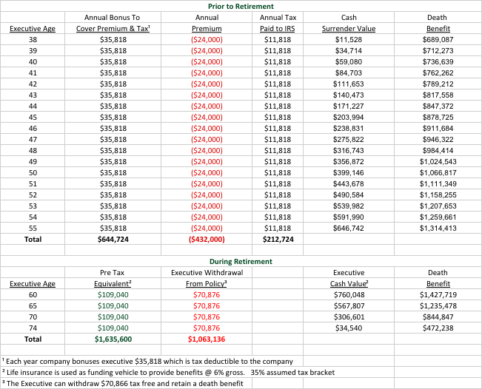
Executive Bonus Plan ~ Example

Slide 6
Executive Bonus Plan
Action Steps
    Select Key Person(s) to participate in plan and the premium amounts
    Determine each Key Person’s insurability
    Select the appropriate life insurance funding vehicle
    Draft and execute executive bonus plan agreement or corporate resolution authorizing the plan
    Regularly review plan with in-force illustrations

Slide 7
Supplemental Executive Retirement Plan ~ SERP
Summary
    The Business offers customized benefits to select Key Persons by executing a non-qualified arrangement to pay the executive a specified benefit at retirement as well as a survivor benefit to his/her family.
    The Business attempts to retain talent and encourage loyalty from Key Persons without having to offer equity.
    The Key Person receives a long-term incentive, salary continuation and survivor benefits as a fringe benefit that is over and above regular compensation.
    The SERP is an ”unfunded, unsecured” promise of the Business which is a current and future liability and is typically offset with corporate owned life insurance. The Executive does not recognize income until retirement.

Slide 8
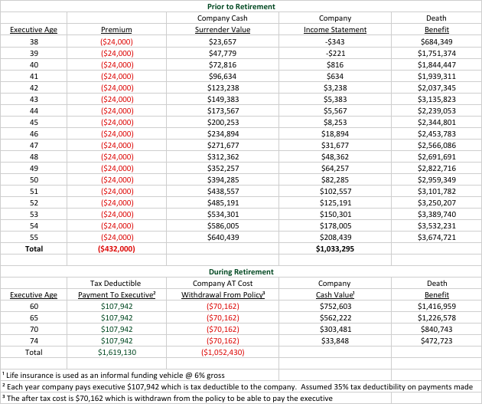
Supplemental Executive Retirement Plan ~ SERP Example

Slide 9
Supplemental Executive Retirement Plan ~ SERP
Action Steps
    Select Key Person(s) to participate in the plan and the retirement/survivor benefit amounts
    Draft and execute SERP agreements and corporate resolution authorizing the plan
    Decide on 3rd party administrator
    Determine each Key Person’s insurability
    Select the appropriate life insurance funding vehicle and satisfy notice and consent requirements for employer-owned life insurance contracts
    Regularly review plan with in-force illustrations

Slide 10
Non-Qualified Plan Financing Vehicles Used

Slide 11
Strategic Use of Life Insurance – “Not Optimized”

Slide 12
Strategic Use of Life Insurance – “Optimized”

Slide 13

Case Study
Ralph (62)
Ralph is known for his skills as an executive and being able to effect positive change as President. He has demonstrated his value to a large manufacturing corporation by moving it from verge of bankruptcy to profitability.
ACRU INSURANCE, LLC PROCESS
Complete Underwriting Advocate
Coordinate framework of SERP and get it approved by Business Owner and Legal Council
CLIENT IMPACT
Paying annual premium of $100,000 for 10 years will generate a pretax retirement benefit of $200,000 to Ralph for retirement.
The plan will also payout benefits to Ralph’s family if he dies or becomes disabled within the 10 years
“We want to show him how much we appreciate him and we want him to remain in his position for the next several years.” — Business Owner

Slide 14

Case Study
Jan
COO Jan is concerned about the underlying policy performance to support Executive Retirement plans for herself and two others. After six years, analysis shows the policies have not performed (-5.15%), and there is a $2,000,000 funding gap between what SERPs promise and what current policies will payout.
ACRU INSURANCE, LLC PROCESS
Collect “in-force” illustrations
Complete Underwriting Advocate
Freeze existing SERP and transfer policies
Create Executive Bonus plan with new policy purchase
CLIENT IMPACT
Each Executive will maintain their original retirement benefits.
The corporate $2,000,000 funding gap is closed by better performing policies and $320,000.
“I’m really glad that we decided to take the necessary steps to really understand this before it was too late”— Jan

