Slide 1


Annuity
Case Studies

Slide 2
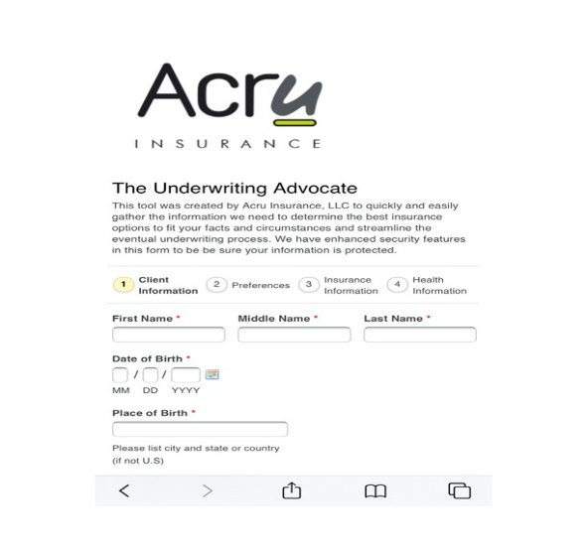
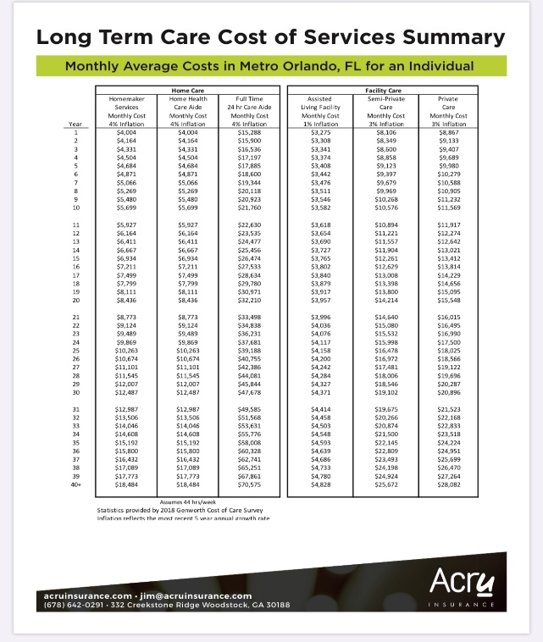
Tools
Underwriting Advocate
Cost of Care
Client Policy Summary

Slide 3

Fixed Indexed Annuity
Jim (66) and Suzanne (65)
Jim and Suzanne have approximately $300,000 in Jim’s IRA and will need additional income.
INSURANCE PROCESS
$100,000 into a five-year indexed annuity
After one year, begin withdrawals 10% penalty free amount, about $850 monthly
Allow other $200,000 to continue to grow in conservative growth stocks
CLIENT IMPACT
Transferred market risk to insurance company and provided stable income with a fair return
Guaranteed Principle
Guaranteed Floor
Stable Income
“I’m very concerned about the market. Where can we get something with good growth and stable income?” – Suzanne
3

Slide 4
Fixed Indexed Annuity
Fixed Index Annuity Market Analysis
Jim, age 66
Insurance Company | ING
Annuity Account Type | Non-Qualified
Product Name | Secure Index 5
Rate Band | >$75,000
Product Type | Fixed Index
Interest Crediting Method | S&P 500 Annual Cap ~ 5% (Other cap options are available)
Guaranteed Interest | 1.00%
Premium Bonus | N/A
Surrender Charges
Year 1 | 8.00%
Year 2 | 7.50%
Year 3 | 6.50%
Year 4 | 5.50%
Year 5 | 4.50%
Year 6 | 0.00%
Year 7 | 0.00%
Year 8 | 0.00%
Year 9 | 0.00%
Year 10 | 0.00%
Income Withdrawal Benefit | N/A
Death Benefit | <Account value or Guarantee Value
Nursing Home Waiver | Yes
Withdrawal Provision | Int. Only in year 1, 10% after year 1
Return of Premium Option | Yes
Market Value Adjustment | yes
Minimum | $15,000
Premium | Single Premium
After
4

Slide 5

Income Annuity
Ted (74)
Ted has owned a non-qualified variable annuity for many years and now has a significant taxable gain.
INSURANCE PROCESS
Contact existing VA company to request best income options – Annuitization vs. Distributions
Shop SPIA marketplace to find favorable alternatives
Tax-free exchange into new SPIA option with “Installment Refund” option to begin annuitization
CLIENT IMPACT
New SPIA has 10% – 20% improved income yields compared to existing annuity
Installment Refund option protects family from the risk of losing money and creates better tax strategy
“I’d like to increase my income in the most tax advantageous way possible.” - Ted
34

Slide 6
Income Annuity
Single Premium Immediate Annuity – Installment Refund
Ted, age 74
 |  | Tax Free | Monthly | Annualized | No | Aggregate
Age | Year | Transfer | Income* | Income* | Inflation Income | Payout
74 | 1 | $100,264 | $676.06 | $8,112.72 | $8,112.72 | $8,112.72
75 | 2 |  |  |  | $8,112.72 | $16,225.44
76 | 3 |  |  |  | $8,112.72 | $24,338.16
77 | 4 |  |  |  | $8,112.72 | $32,450.88
78 | 5 |  |  |  | $8,112.72 | $40,563.60
79 | 6 | Basis = $28,500 | *Non-taxable = $148.06 | *Non-taxable = $1,776.72 | $8,112.72 | $48,676.32
80 | 7 |  | *Taxable = $528.00 | *Taxable = $6,336.00 | $8,112.72 | $56,789.04
81 | 8 |  |  |  | $8,112.72 | $64,901.76
82 | 9 |  |  |  | $8,112.72 | $73,014.48
83 | 10 |  |  |  | $8,112.72 | $81,127.20
84 | 11 |  |  |  | $8,112.72 | $89,239.92
85 | 12 |  |  |  | $8,112.72 | $97,352.64
86 | 13 |  |  |  | $8,112.72 | $105,465.36
87 | 14 |  |  |  | $8,112.72 | $113,578.08
88 | 15 |  |  |  | $8,112.72 | $121,690.80
89 | 16 |  |  |  | $8,112.72 | $129,803.52
90 | 17 |  |  |  | $8,112.72 | $137,916.24
91 | 18 |  |  |  | $8,112.72 | $146,028.96
92 | 19 |  |  |  | $8,112.72 | $154,141.68
93 | 20 |  |  |  | $8,112.72 | $162,254.40
94 | 21 |  |  |  | $8,112.72 | $170,367.12
95 | 22+ |  |  |  | $8,112.72 | $178,479.84
See Insurance Company Illustration dated 1/26/14 ~ see proposal for details
After
35

